Slide 1
MSc Artificial Intelligence
Knowledge Engineering
Week 1: Logic in AI
Notes:
This colour bar is to be used for Artificial Intelligence

Slide 2

Logical Reasoning
Einstein’s Riddle
There are five houses.
The Englishman lives in the red house.
The Spaniard owns the dog.
Coffee is drunk in the green house.
The Ukrainian drinks tea.
The green house is immediately to the right of the ivory house.
The Old Gold smoker owns snails.
Kools are smoked in the yellow house.
Milk is drunk in the middle house.
The Norwegian lives in the first house.
The man who smokes Chesterfields lives in the house next to the man with the fox.
Kools are smoked in the house next to the house where the horse is kept.
The Lucky Strike smoker drinks orange juice.
The Japanese smokes Parliaments.
The Norwegian lives next to the blue house.
Who drinks water?
Who owns the zebra?
5 | 3 |  |  | 7
6 |  |  | 1 | 9 | 5
 | 9 | 8 |  |  |  |  | 6
8 |  |  |  | 6 |  |  |  | 3
4 |  |  | 8 |  | 3 |  |  | 1
7 |  |  |  | 2 |  |  |  | 6
 | 6 |  |  |  | ? | 2 | 8
 |  |  | 4 | 1 | 9 |  |  | 5
 |  |  |  | 8 |  |  | 7 | 9

Slide 3
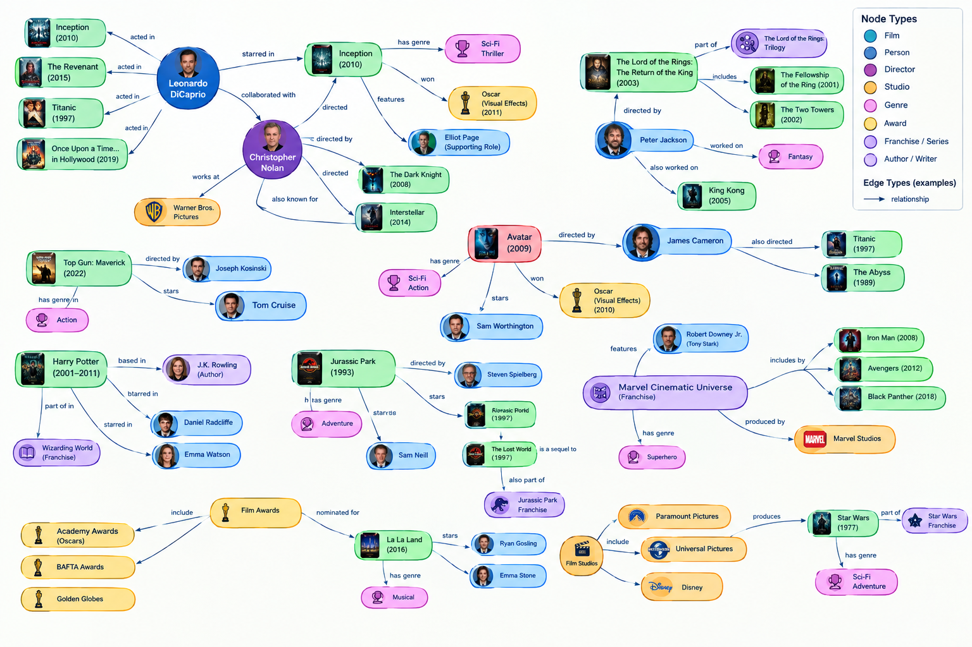
Graph Representations of Knowledge

Slide 4
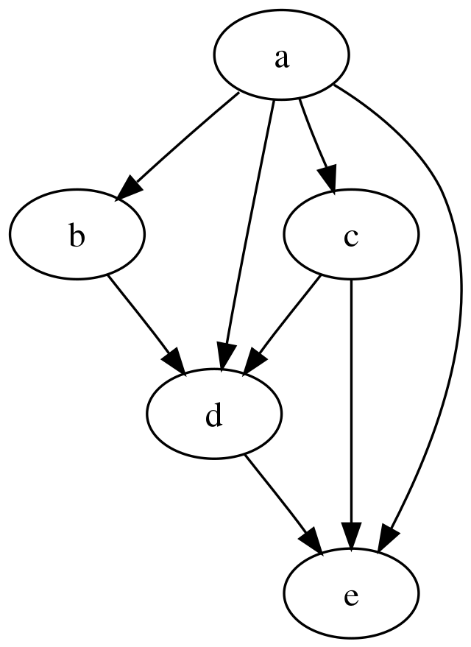
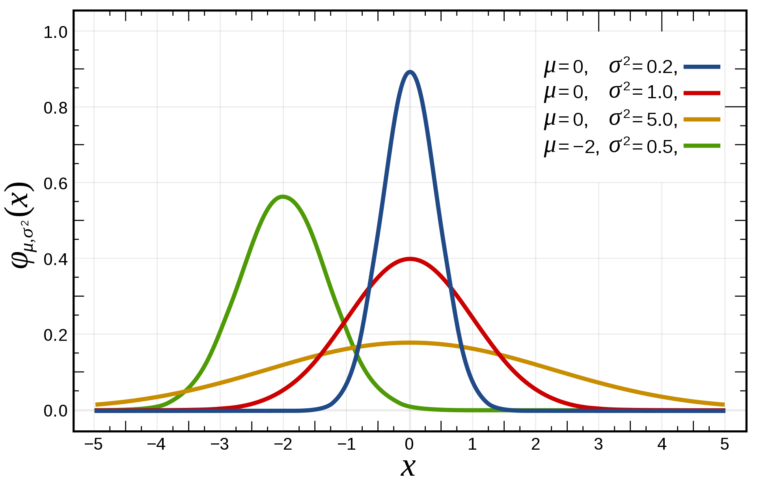
Probabilistic Reasoning
P(a,b,c,d,e)=P(e|a,c,d) P(d|a,b,c) P(b|a) P(c|a) P(a)

Slide 5
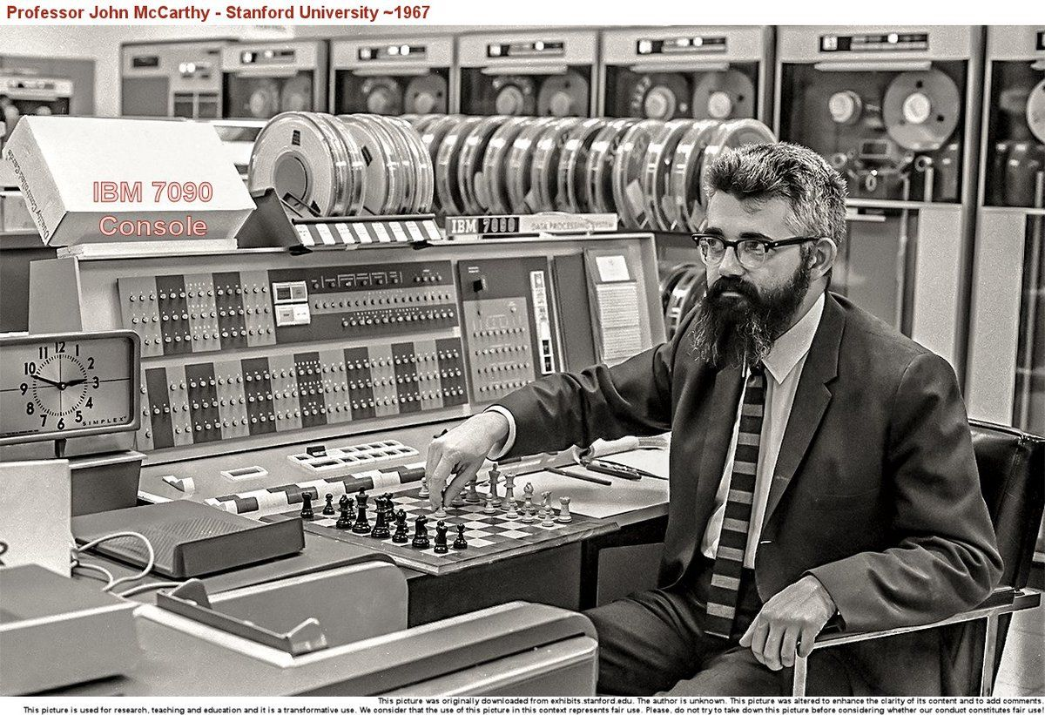
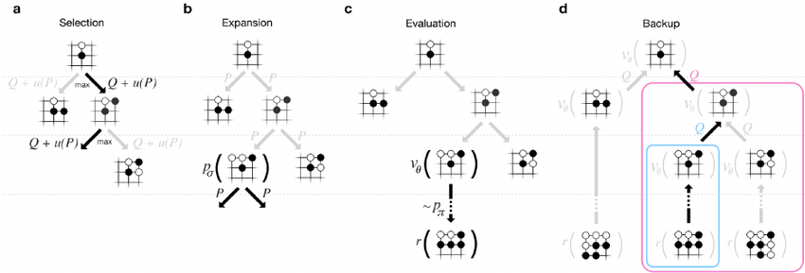
Symbol Manipulation and Intelligence
  Early AI researchers regarded reasoning as central to intelligence
  Minsky, McCarthy et al placed great emphasis on symbol manipulation
  Expert systems were very popular in the 1970s
  Why?
  And why did symbolic AI "fail"?
  Lots of current effort to get ML systems to do symbol manipulation
    AlphaGo, AlphaFold both include elements of symbolic reasoning

Slide 6
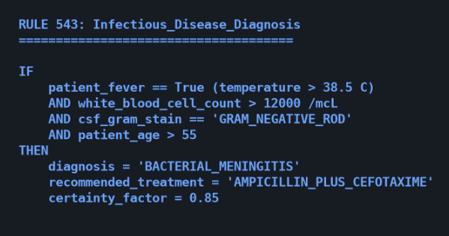
Limitation of Expert Systems
Inflexible to Uncertainty
Rule-based systems are exceptionally rigid. They struggle to adapt to unstructured data, edge cases, or scenarios that fall outside of their explicitly programmed logic.
The Knowledge Bottleneck
Also known as the "Knowledge Acquisition Bottleneck." It is practically impossible to manually code every single rule required to handle complex, real-world variability.
MYCIN: A 1970s Medical Expert System

Slide 7
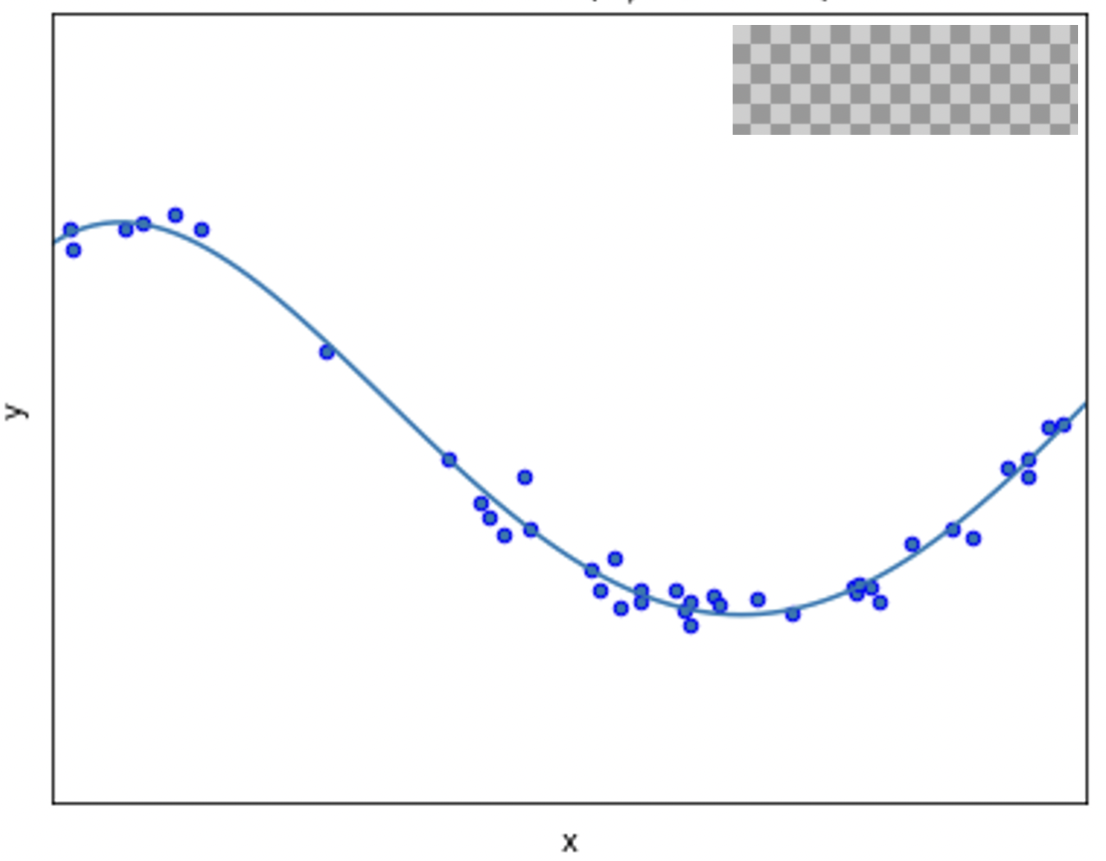
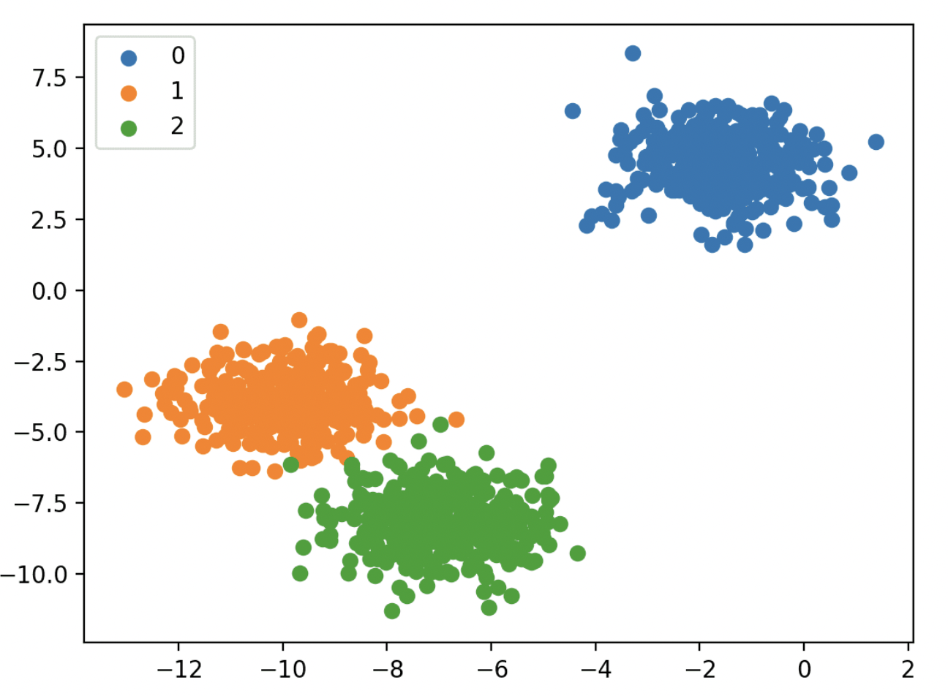
The Data-Driven Era: Machine Learning
The Statistical Shift
The Paradigm: Algorithms learn statistical patterns from historical data, replacing explicitly programmed rules.
How it Works: Optimizes mathematical models based on structured data and human-engineered features.
Strengths: Highly scalable; handles uncertainty and noisy data much more gracefully than GOFAI.
The Bottleneck: Heavily reliant on manual feature engineering; struggles with raw, unstructured data.
Regression
Classification

Slide 8
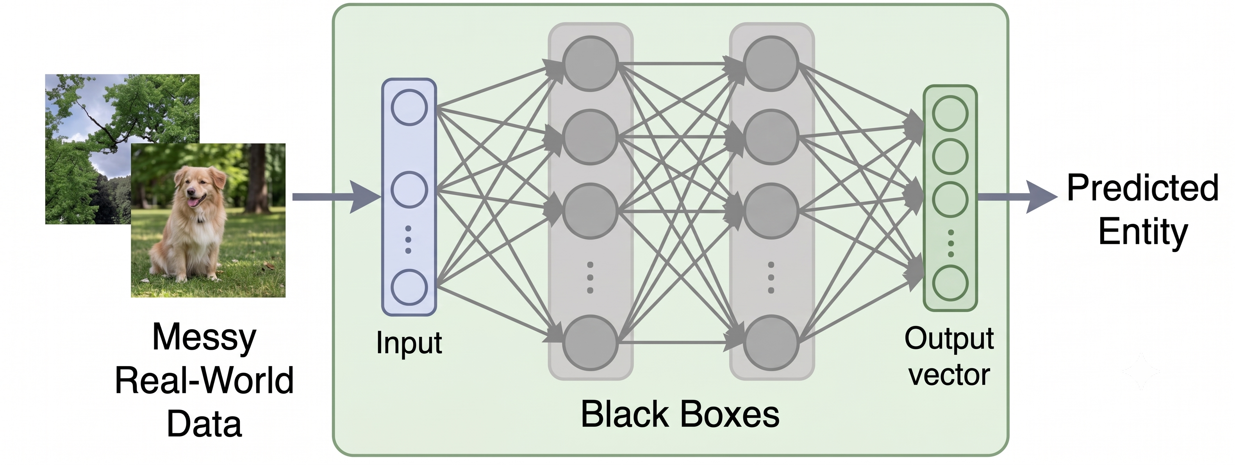
The Power of Representation: Deep Learning
The Paradigm: Multi-layered neural networks automatically discover complex representations for feature detection.
How it Works: Learns non-linear mappings directly from raw, unstructured data (e.g., images, text).
Strengths: Achieves unprecedented accuracy in computer vision and NLP; completely eliminates the need for manual feature engineering.
The Bottleneck: The "Black Box" problem. It lacks explainability, requires massive amounts of training data, and cannot perform strict logical reasoning.

Slide 9
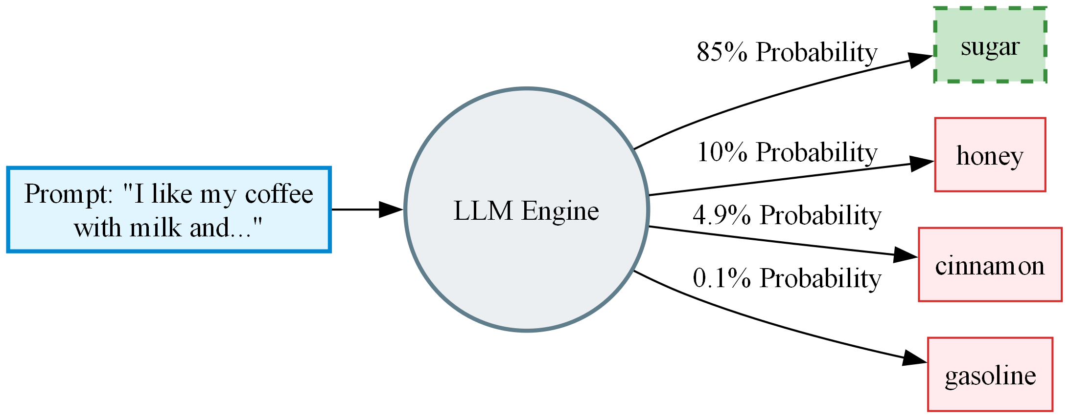
The Modern AI Dilemma
Large Language Models: At their core, LLMs generate text simply by calculating a probability distribution and predicting the most likely "next word" in a sequence.
The Result (Hallucination): Because this foundational mechanism prioritizes statistical likelihood over factual accuracy, the model can confidently string together plausible-sounding but entirely invented information.

Slide 10
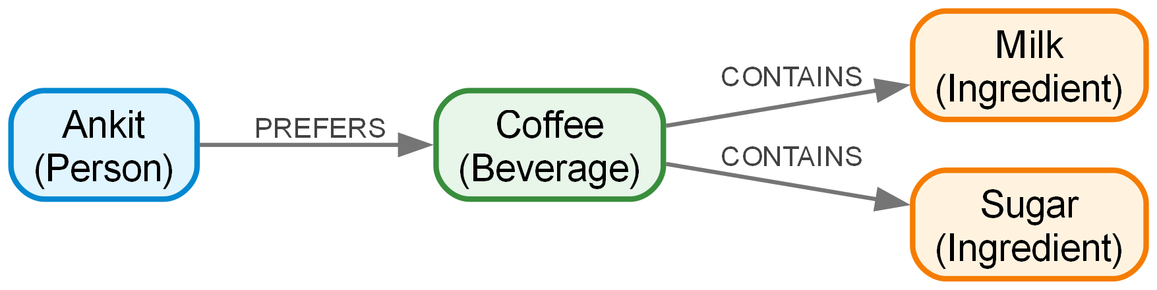
The Solution: Knowledge Graphs as Guardrails
Structured Truth, Not Probability: Unlike LLMs, Knowledge Graphs do not guess. They store explicit, mathematically formalized relationships between real-world entities.
Factual Guardrails: By connecting an LLM to a Knowledge Graph, we constrain its text generation. It can only speak based on the verified facts it retrieves.
Safe Reasoning: The model stops "rolling the dice" for the next word and becomes a transparent reasoning engine grounded in actual truth.

Slide 11
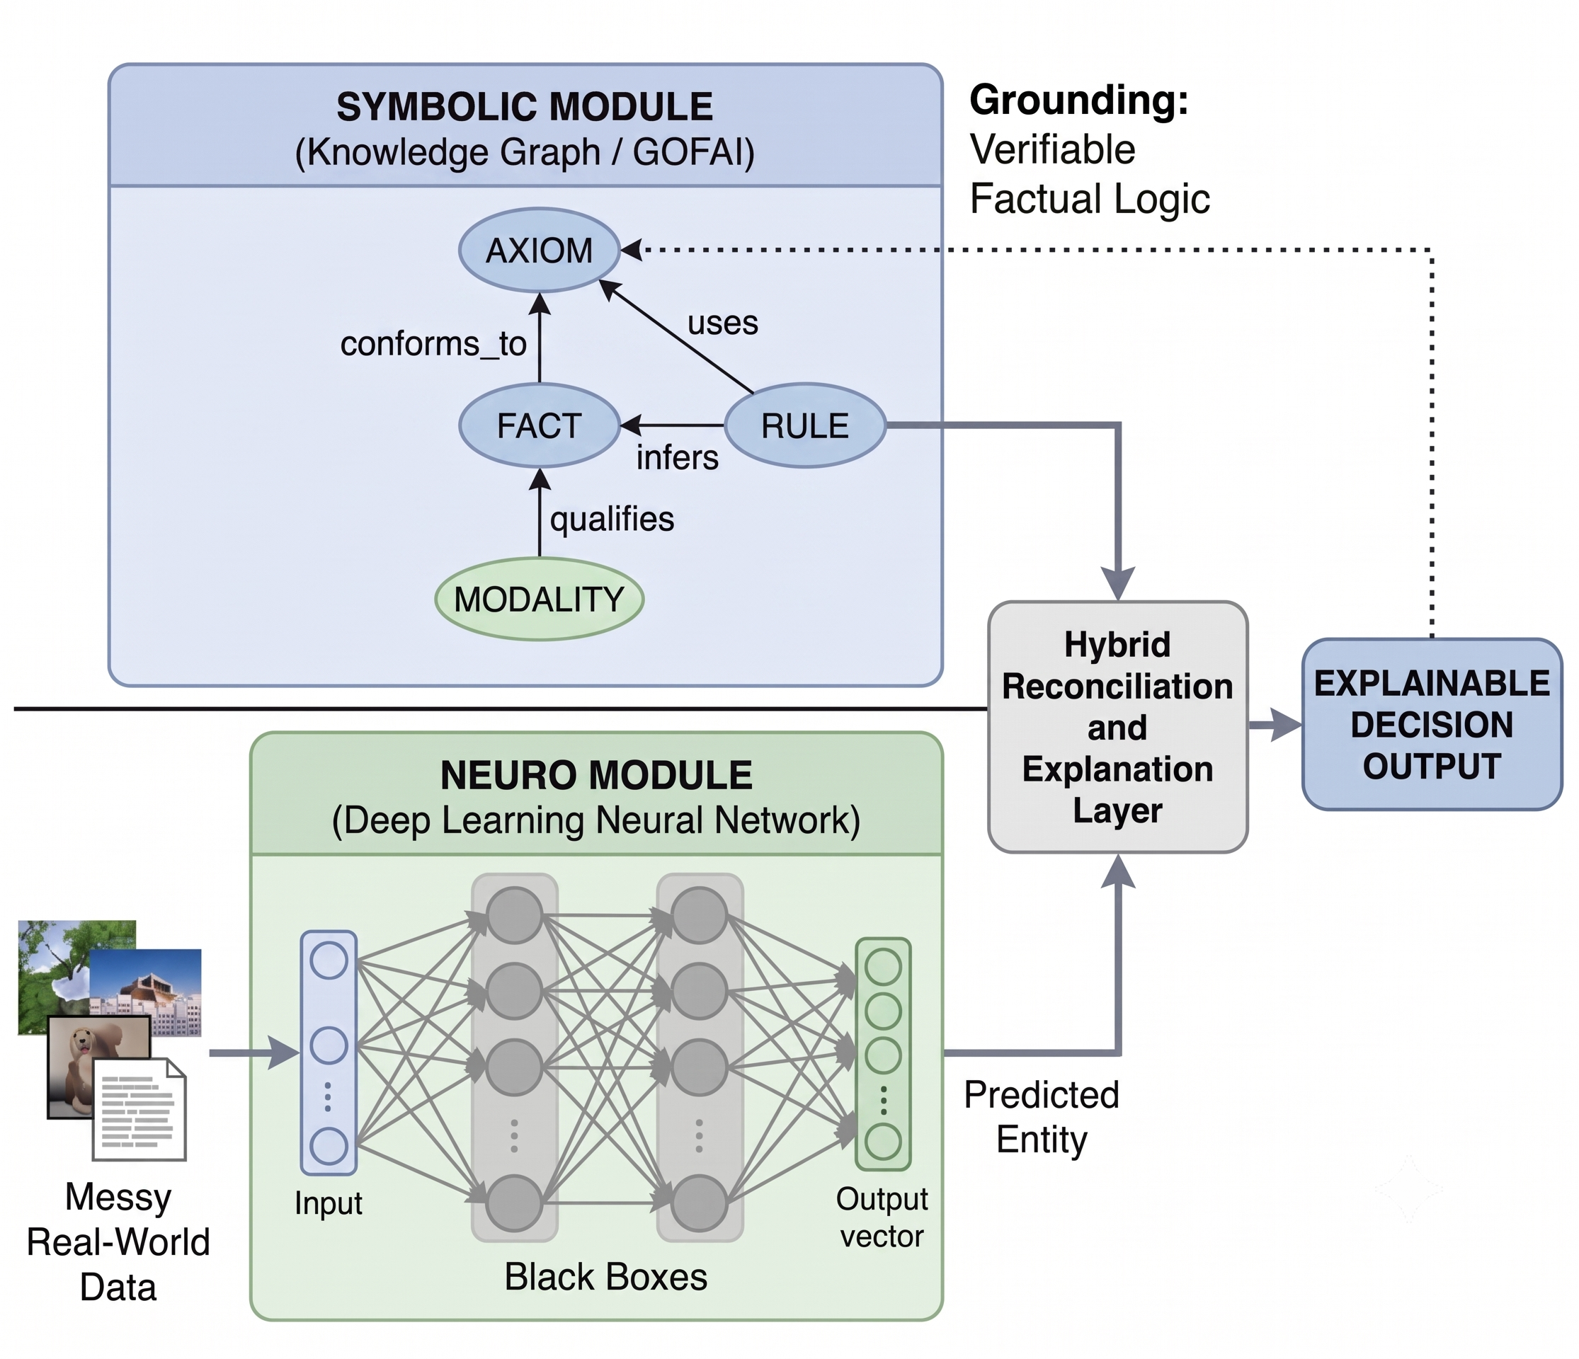
The Hybrid Future: Neuro-Symbolic AI
Bridging the Gap: Combines the robust learning capabilities of Neural Networks (Deep Learning) with the logical reasoning and explainability of Symbolic AI (GOFAI).
Knowledge Graphs: Uses structured ontologies (nodes and relationships) to ground the "Black Box" predictions of deep learning models in verifiable, factual logic.
The Ultimate Goal: Systems that can learn independently from messy data, yet still reason logically and explain exactly why they made a decision.

Slide 12
Learning Outcomes
Successful students will be able to:
Gain a systematic understanding of knowledge, principles and procedures of knowledge engineering
Demonstrate a critical awareness and evaluation of current and complex issues and developments in knowledge engineering
Demonstrate critical understanding of research techniques in knowledge engineering and ability to critically evaluate them
Demonstrate innovative application of the knowledge, principles and procedures of knowledge engineering in making sound judgements and proposing new hypotheses

Slide 13
Outline Syllabus
Logic
  Propositional logic
  First order logic
  Natural Deduction
  Automated Reasoning
Knowledge and knowledge representation
  Knowledge Bases
  Knowledge Graphs
  Large Language Models & RAG
Reasoning under Uncertainty
  Probabilities, conditional independence;
  Bayesian networks
  Causal Reasoning (if time)

Slide 14
How the Course will be Taught
Lectures will be kept short-ish and single topic
There are extensive written notes on canvas. You need to read these.
Lots of problems to work though – some paper-based
Plenty of live coding
We will code almost everything ourselves
  Python libraries for this are bad/nonexistent
  Coding develops understanding
  Learn a little more Python

Slide 15
Assessment
Two one hour class tests worth 20% each
  Week 4, Monday 12 October, 09:30am start
  Week 11, Friday 30 November, 09:30am start
  These will be invigilated and will be multiple choice.
  You must be present in person for these
One course project worth 60%
  You will undertake an open-ended practical project, using techniques from the module as you deem appropriate.
  Project will be assess on outcome and process
    You will be expected to demonstrate consistent work on the project by submitting a weekly project “log”
  Released in week 4

Slide 16
Advice
Read the notes, ideally before the lecture
Do the exercises, there is time in class to do this
Come to the class, talking to me and each other will help you
Be on time, if you are 15 minutes late then you will be catching up for the whole day.
AI is of most help to those who already understand what they doing

Slide 17
Can you solve them?
Einstein’s Riddle
There are five houses.
The Englishman lives in the red house.
The Spaniard owns the dog.
Coffee is drunk in the green house.
The Ukrainian drinks tea.
The green house is immediately to the right of the ivory house.
The Old Gold smoker owns snails.
Kools are smoked in the yellow house.
Milk is drunk in the middle house.
The Norwegian lives in the first house.
The man who smokes Chesterfields lives in the house next to the man with the fox.
Kools are smoked in the house next to the house where the horse is kept.
The Lucky Strike smoker drinks orange juice.
The Japanese smokes Parliaments.
The Norwegian lives next to the blue house.
Who drinks water?
Who owns the zebra?
5 | 3 |  |  | 7
6 |  |  | 1 | 9 | 5
 | 9 | 8 |  |  |  |  | 6
8 |  |  |  | 6 |  |  |  | 3
4 |  |  | 8 |  | 3 |  |  | 1
7 |  |  |  | 2 |  |  |  | 6
 | 6 |  |  |  | ? | 2 | 8
 |  |  | 4 | 1 | 9 |  |  | 5
 |  |  |  | 8 |  |  | 7 | 9

Slide 18
1.01 Exercises Logic and Knowledge

Slide 19
What reasoning abilities did you use?
Do these tasks require intelligence?
What do they have in common?
Knowledge acquired incrementally
When new knowledge is discovered, have to revisit old knowledge to draw conclusions
Can we write computer programs to solve them?
Can we write one computer program that will solve them all?
Why are games like these relevant to real-world problems?

Slide 20
Reasoning and Intelligence
  Why, in an era of big data, do we need to study logic?
  Are models learned from data always correct?
  What if we need provably correct results?
  True intelligence needs to be able to reason rigourously.

Slide 21
Logic and Intelligence
  “If intelligence requires reasoning
  And logic is the study of reasoning
  Then…?”
  A more cliched example:
  Socrates is a man
  All men are mortal
  …
  A deductive truth.
  Should AI systems be able to do this?

Slide 22
Propositional Logic
  Humans know facts
- It is colder in the winter than in the summer.
- Mount Everest is the tallest mountain in the world.
- Water makes you wet.
  Facts are grounded: we know what a mountain is
  How do these facts differ from data?

Slide 23
Propositional Logic
  Humans can reason over facts
  We can make decisions and draw conclusions
  Can we get computers to do the same?
  Computers require a formal language: Logic
  Logic – the study of correct reasoning- will allow us to formally represent facts and reason about them
  Propositional Logic is a simple form of logic that allows us to do just this

Slide 24
Propositions
  A proposition is a statement that can be True or False
    It is colder in the winter than in the summer.
    Mount Everest is the tallest mountain in the world.
    Water makes you wet.
  A Premise is a stated proposition and is like an axiom
  A Conclusion is derived purely from the premise
  Socrates is a man [Premise]
  All men are mortal [Premise]
  Therefore, Socrates is mortal [Conclusion]

Slide 25
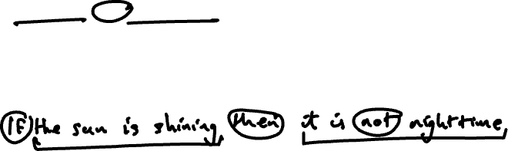
Connectives
  “Water makes you wet” is an atomic proposition
  We can connect these together to get new compound propositions
    The car is blue and fuelled by petrol (The car is blue and the car is fuelled by petrol)
    Books have hard or soft covers (Books have hard covers or books have soft covers)
    If the sun is shining then it is daytime (If the sun is shining then it is daytime)

Slide 26
Correctness
  If we use correct reasoning, if the premises of an argument are true then its conclusion must be True
    Socrates is a man
    All men are mortal
    Therefore Socrates is mortal
  Is our reasoning correct:
    Some apples are red
    All apples are tasty
    Therefore, all red apples are tasty

Slide 27
Validity and Soundness
  Is our reasoning correct:
    Some apples are red
    Some apples are tasty
    Therefore, some red apples are tasty
  This is an INVALID argument
  Is our reasoning correct:
    All apples are red
    Some apples are tasty
    Therefore, some red apples are tasty
  This is VALID but is not SOUND
  CORRECT DEDUCTIVE REASONING MUST BE BOTH VALID AND SOUND

Slide 28
1.03 Exercises Propositional Logic

Slide 29
Formal Propositional Logic
Humans are excellent at reasoning using natural language, but machines are not.
To automate deductive reasoning, we need to reduce it to symbol manipulation
One symbol to represent each atomic proposition
Each symbol can be True or False

Slide 30
Making Logical Arguments Formal
If it is not raining and I am going outdoors then I do not take a coat or an umbrella.
What are the atomic propositions?
  R: It is raining
  O: I am going outdoors
  C: I will take a coat
  U: I will take an umbrella
Each can be True or False

Slide 31
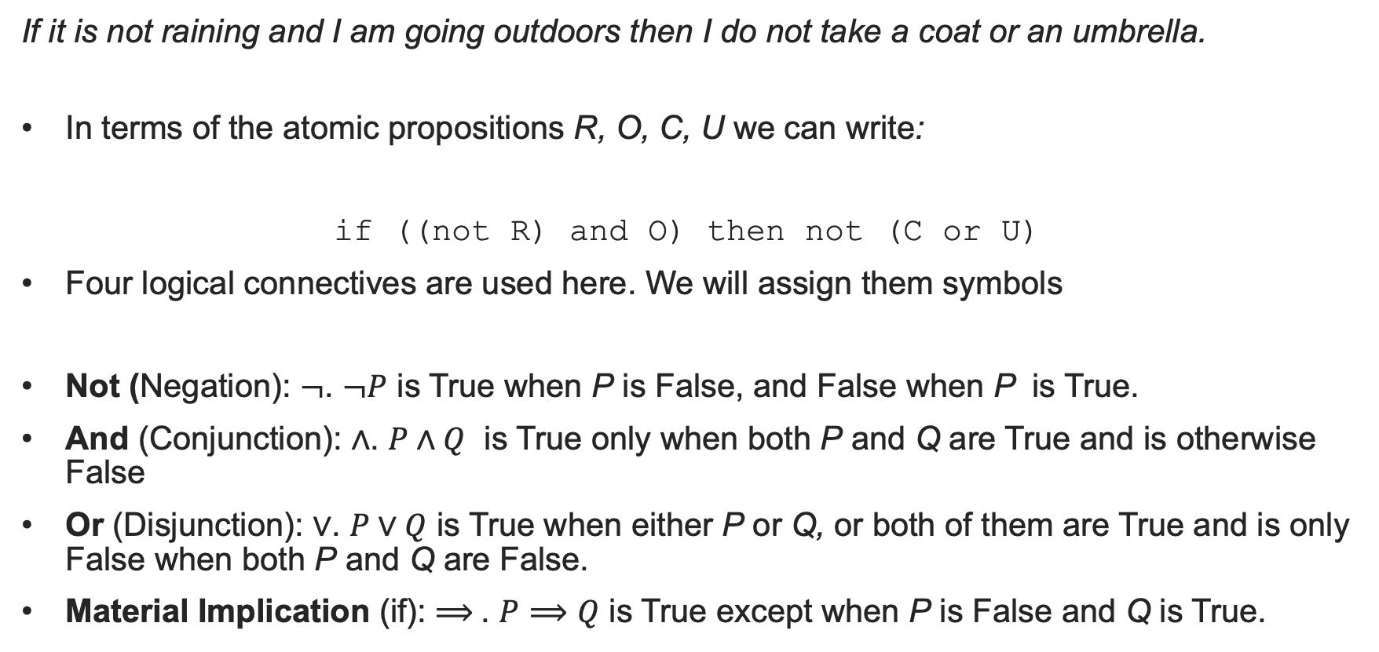
Logical Connectives
If it is not raining and I am going outdoors then I do not take a coat or an umbrella.
In terms of the atomic propositions R, O, C, U we can write:
if ((not R) and O) then not (C or U)
Four logical connectives are used here. We will assign them symbols
Not (Negation): $¬$. $¬P$ is True when P is False, and False when P is True.
And (Conjunction): $∧$. $P∧Q$ is True only when both P and Q are True and is otherwise False
Or (Disjunction): $∨$. $P∨Q$ is True when either P or Q, or both of them are True and is only False when both P and Q are False.
Material Implication (if): $⟹$. $P⟹Q$ is True except when P is False and Q is True.

Slide 32
Truth Tables
The effect of Logical connectives is best illustrated by their Truth Tables
A Truth table tells us whether a Compound proposition is True or False depending on the Truth of the compound propositions
Is the statement “if it is cold I wear a hat” True or False if the statements “I am wearing a hat” and “it is not cold” are both true?
Understanding these will help us to model our knowledge using propositions

Slide 33
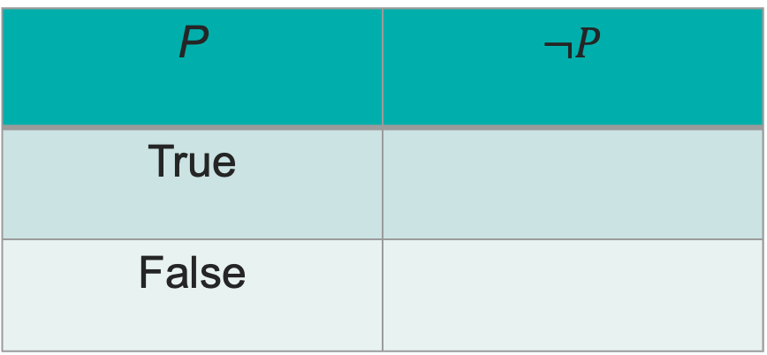
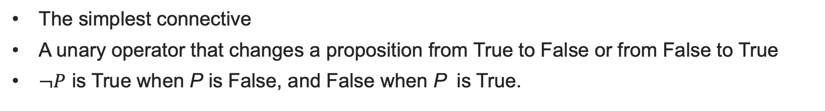

Negation (Not)
The simplest connective
A unary operator that changes a proposition from True to False or from False to True
$¬P$ is True when P is False, and False when P is True.
P | $¬P$
True
False

Slide 34
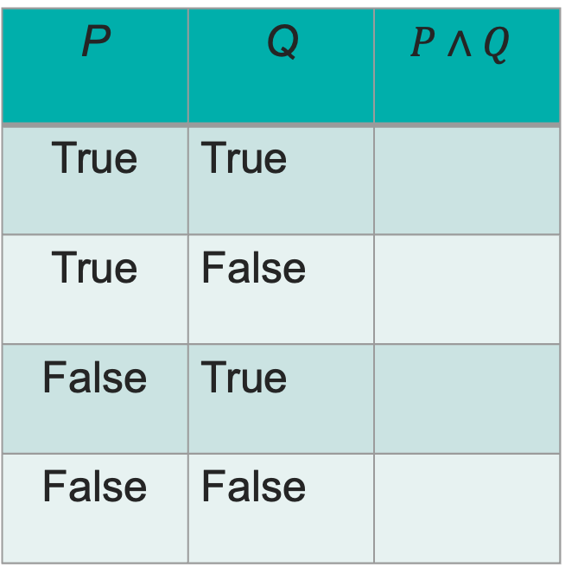
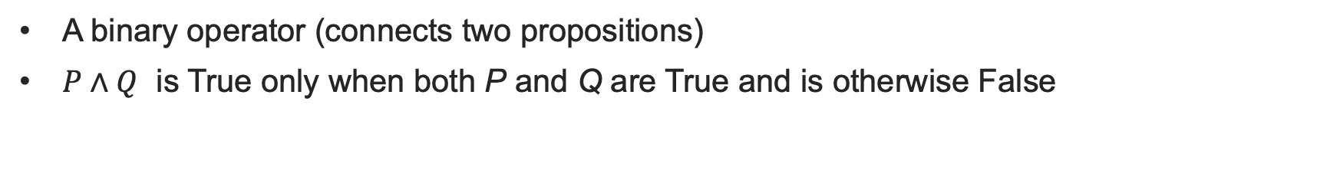
Conjunction (And)
A binary operator (connects two propositions)
$P∧Q$ is True only when both P and Q are True and is otherwise False
P | Q | $$P∧Q$$
True | True
True | False
False | True
False | False

Slide 35

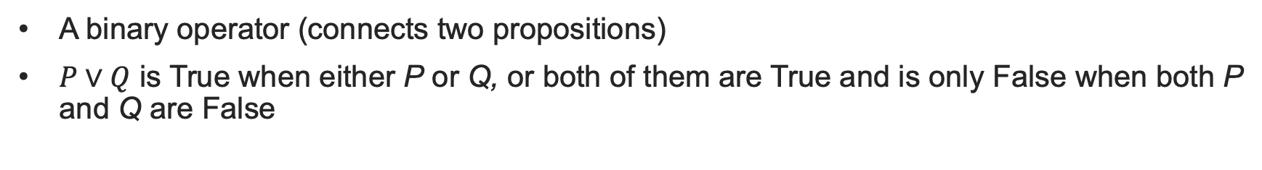

Disjunction (Or)
A binary operator (connects two propositions)
$P∨Q$ is True when either P or Q, or both of them are True and is only False when both P and Q are False
P | Q | $$P∨Q$$
True | True
True | False
False | True
False | False

Slide 36



Material Implication
P | Q | $$P⟹Q$$
True | True
True | False
False | True
False | False
More subtle
$P⟹Q$ is read as “if P then Q”.
Not the same as if..then in programming
No native Python operator.
Can you write a lambda function implies(P,Q)?

Slide 37
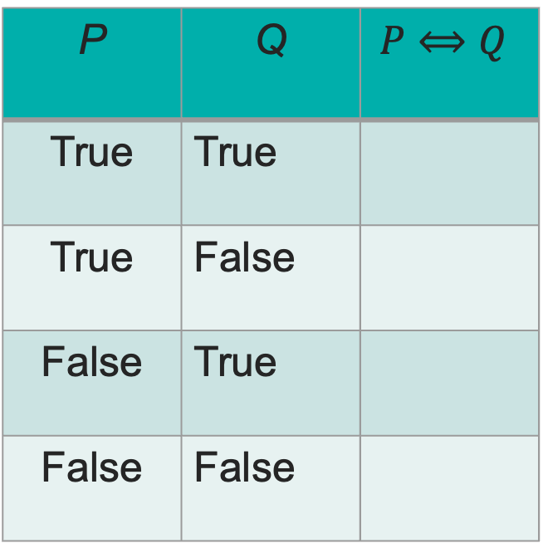
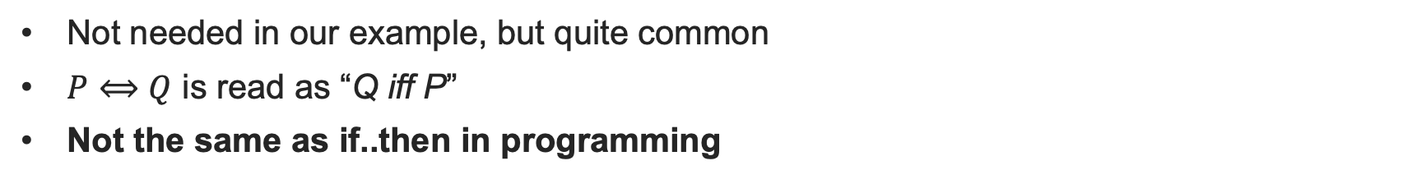
Biconditional
Not needed in our example, but quite common
$P⟺Q$ is read as “Q iff P”
Not the same as if..then in programming
P | Q | $$P⟺Q$$
True | True
True | False
False | True
False | False

Slide 38
Back to our example
If it is not raining and I am going outdoors then I do not take a coat or an umbrella.
if ((not R) and O) then not (C or U)
Exercise: Can you compute the Truth Table for this?

Slide 39
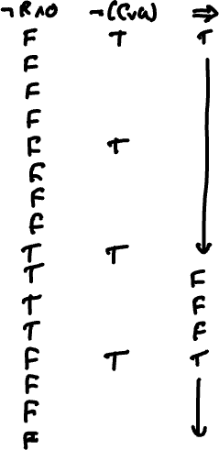
R | O | C | U
T | T | T | T
T | T | T | F
T | T | F | T
T | T | F | F
T | F | T | T
T | F | T | F
T | F | F | T
T | F | F | F
F | T | T | T
F | T | T | F
F | T | F | T
F | T | F | F
F | F | T | T
F | F | T | F
F | F | F | T
F | F | F | F

Slide 40
1.05 Exercises Formal Propositional Logic

Slide 41
Knowledge Bases
We have now studied enough knowledge to build a knowledge base.
What exactly do we mean by this?
We introduce the concept of an intelligent agent
The agent lives in some abstract world
  A chess board
  A Roomba
  A medical database
The agent has a goal that it must achieve.

Slide 42
How can agents achieve their goals?
Examples of agent goals:
  Capture the opponent’s King
  Vacuum the entire floor area
  Find a combination of medicines for a set of symptoms
The agent must be able to
  Observe its environment
    The opponent’s King is on square E8
    The cat’s bed is in the corner by the heater
    Medicines X addresses disease Y
  Ask question about its environment to determine new knowledge
    If I move my knight to A6, what could happen?
    Medicines A and B address diseases X and Y but should not be taken together
  Reason over the knowledge to ask a set of questions that enable decisions to be taken that achieve the goal

Slide 43
Knowledge Bases
  A knowledge base records what the agent knows as a set of propositions
  It may contain some prior information (premises)
  It is written in formal notation to enable computation
  The agent can update it as it discovers new things about the world
  The agent aims to find one or more models that make the knowledge base True
  Let’s develop an example:

Slide 44
A Familiar Riddle
Ahmed, Niamh, and Xin are three friends. They went for dinner together. Each of them ordered a main course (stew, daal, falafel) and a dessert (ice cream, apple pie, cheesecake. They each ordered a different main course and a different dessert. Use the following information to deduce who ordered what:
1. The person who ordered the stew did not order the apple pie
2. Niamh ordered the Dhal
3. Ahmed ordered the ice cream or the apple pie
4. Xin did not order either the ice cream or the cheesecake
5. The person who ordered the ice cream did not order the falafel
Can you formalize this?

Slide 45
Proofs in Logic
  All men are mortal
  Socrates is a man
  Therefore Socrates is mortal
  We claim that this is sound and valid argument, but how do we know this?
  Soundness is a matter of the truth of the propositions
  Validity is whether the reasoning is correct
  How can we unambiguously determine the validity of an argument?

Slide 46
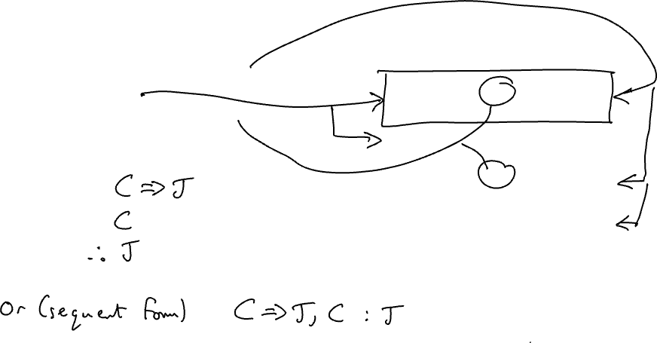
Truth Tables
C | J | C=>J
T | T | T
T | F | F
F | T | T
F | F | T
  If it is cold, I wear a jacket
  It is cold
  Therefore, I wear a jacket
  In symbols:

Slide 47
Model Checking
Each line of the truth table is called a model
All arguments can be rigourously checked by enumerating all possible models
An argument is valid iff there is at least one model for which all of the premises are True and the conclusion is True
This is known as model checking
The gold standard, but nearly always impractical

Slide 48
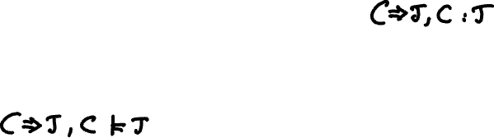
Model Checking
One way around the combinatorial explosion problem is to identify common parts of an argument, model check those, and then use them as part of a larger argument
Consider our earlier argument (written in sequent form):
We have verified this by truth table and can therefore take it as proven as rigorously as possible (semantically correct). We denote this as:
This is known as modus ponens (method of affirming) and is widely used as the basis for automated reasoning.

Slide 49
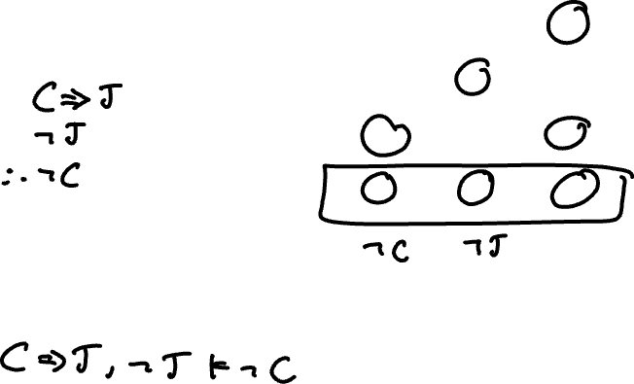
Truth Tables
C | J | C=>J
T | T | T
T | F | F
F | T | T
F | F | T
  If it is cold, I wear a jacket
  I am not wearing a jacket
  Therefore, it is not cold
  In symbols:
  Modus Tollens (method of removing by taking away)

Slide 50
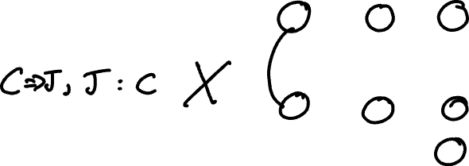
Truth Tables
C | J | C=>J
T | T | T
T | F | F
F | T | T
F | F | T
  If it is cold, I wear a jacket
  I am wearing a jacket
  Therefore, it is cold
  In symbols:
  Affirming the consequent, or fallacy of the converse

Slide 51
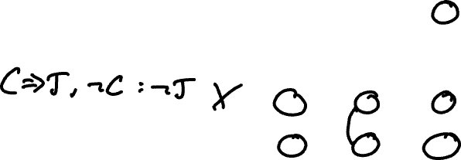
Truth Tables
C | J | C=>J
T | T | T
T | F | F
F | T | T
F | F | T
  If it is cold, I wear a jacket
  It is not cold
  Therefore, I am not wearing a jacket
  In symbols:
  Denying the antecedent or fallacy of the inverse

Slide 52
Natural Deduction
Truth tables are impractical for larger problems
15 variables – 2¹⁵ = 32,768 models is feasible
50 variables is challenging!
We could simplify by exploiting constraints and check only models that we cannot immediately rule out
Not always obvious…
Can we instead formalize deductive reasoning?

Slide 53
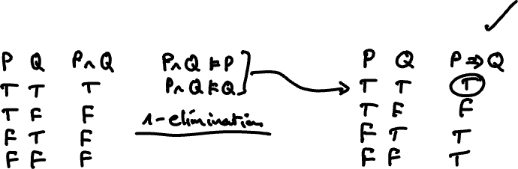
Natural Deduction
Model checking can be used to determine inference rules
These can be used to construct an argument to prove or disprove a proposition
Simple example: if P^Q is True, is P=> Q True?

Slide 54


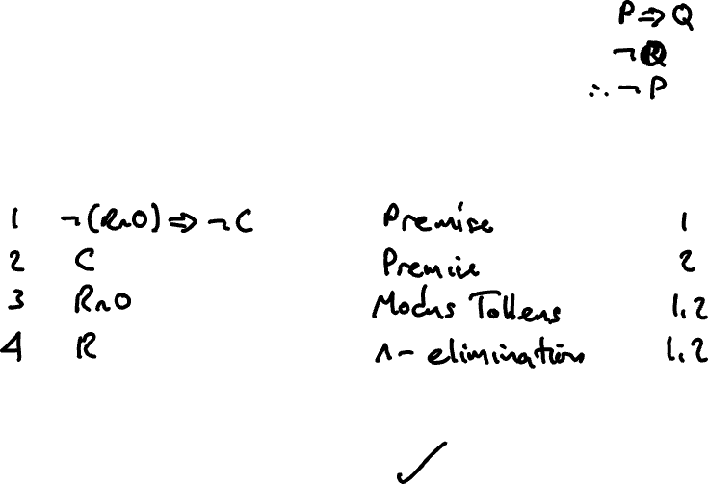
Example of a Formal Proof
Step |  | Inference Rule | Premises used

Slide 55
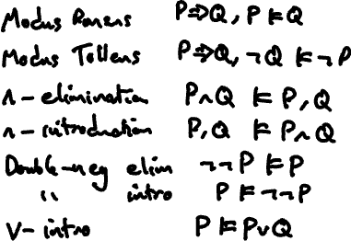
Common Inference Rules
P | Q
T | T
T | F
F | T
F | F

Slide 56
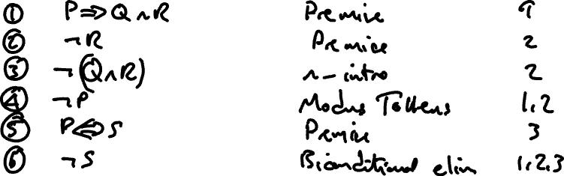
A more complex Proof
Step |  | Inference Rule | Premises used

Slide 57
Some more Natural Deduction
OR Introduction
Step |  | Inference Rule | Premises used

Slide 58
Proving Invalid Arguments
If you’re finding it hard to prove an argument, that could be because it is invalid!
You see if this is the case, you might try:
  Proving the negation of the conclusion
  Derive a contradiction by proving both the conclusion and its negation, or by deriving the negation of one of the premises

Slide 59
1.07 Exercises Natural Deduction

Slide 60
Day 1 Wrap-up
Today
Relationship between Logic and Reasoning
Propositional Logic – sentences that are True of False
Formalisation of Propositional Logic
Knowledge Bases
Natural Deduction
Homework
Complete the Natural Deduction Exercises
Wednesday
Solutions to the Natural Deduction Exercises
Introduction to Logic Programming with Kanren

Slide 61
MSc Artificial Intelligence
Knowledge Engineering
Week 1: Logic
Notes:
This colour bar is to be used for Artificial Intelligence

Slide 62
Getting ready for some programming
Anaconda is the Python Distribution we will use in this module
Download Anaconda from https://www.anaconda.com/download
Set this going now

Slide 63
Recap from Day 1
On day 1 we learned:
  To represent and reason about knowledge using Logic
  The principles of Propositional Logic
  Proving argument correctness
On day 2 we will:
  Learn how to use an automated tool for natural deduction

Slide 64
1.07 Exercises Natural Deduction

Slide 65
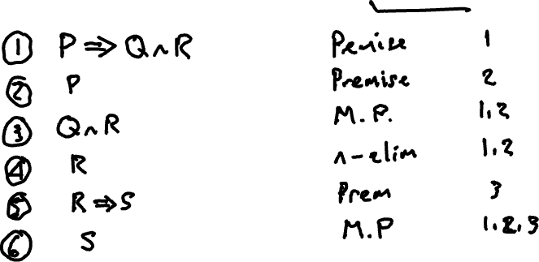

Slide 66
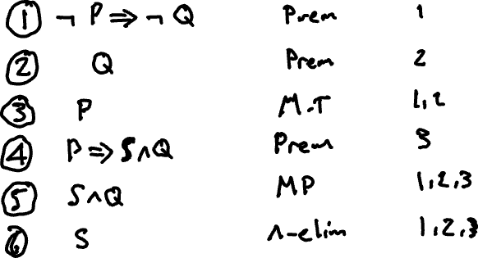

Slide 70
Automated Reasoning with Kanren
Open the Kanren Tutorial Notebook and code along…

